Slide 1
Chapter 0 Introduction

Slide 2
0.1 A Brief History of Computers
What is a computer?
A mechanical or electronic device
Stores, retrieves, manipulates large amounts of information at high speed, with great accuracy
Does not need human intervention
Carries out instructions from a program

Slide 3
The Pioneers
Mid-1800’s: Charles Babbage built the Analytical Engine
made from axles and gears that could store and process 40 digit numbers
assisted by Ada Byron who has a major programming language named after her (RAPTOR built on Ada)
1940: Howard Aitken at Harvard, with John Atanasoff and Clifford Berry at Iowa State U. created Mark I, an electronic computer.
could not act on intermediate results.
1945: John Mauchly and J. Presper Eckert at U. Pennsylvania built the ENIAC (Electronic Numerical Integrator and Calculator)
weighed 33 tons, 17,000 vacuum tubes
performed up to 5000 additions per second

Slide 4
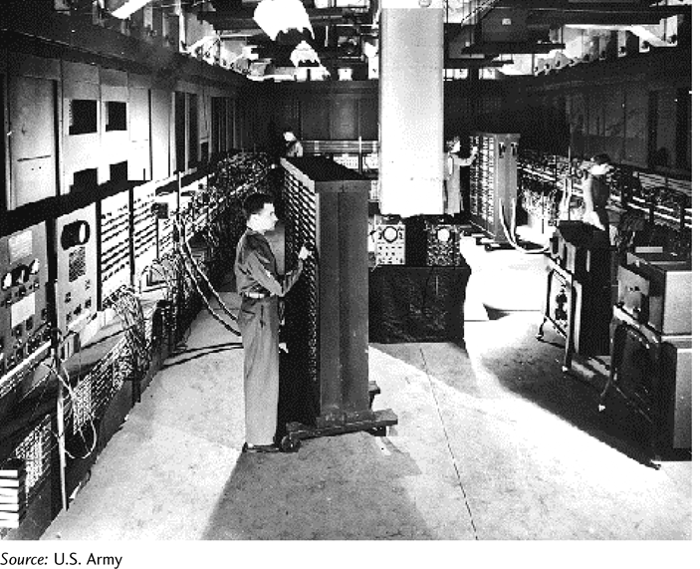
ENIAC: the computer of the 1940’s!

Slide 5
Early Computers: 1940’s – 1950’s
1945 – 1950’s: First generation computers
used vacuum tubes to do internal switching needed for computations
1955: about 300 computers in the world based on vacuum tubes
Late 1950s: invention of the transistor was one of most important inventions of 20th Century
computers based on the transistor are the first solid-state computers
need climate-controlled environment

Slide 6
The Personal Computer
1970s: The personal computer becomes available with invention of the microchip
1974: The microchip, along with the invention of the microprocessor led to creation of first personal computer
Bill Gates and Paul Allen founded Microsoft Corporation
Stephen Wozniak and Steven Jobs founded Apple Computer, Inc.

Slide 7
Computers Today
Supercomputers are very powerful and specialized and are used for massive computing problems by big corporations and government departments
Mainframes are in use at large corporations
Desktop computers and Laptops:
PCs: computers that use the Microsoft Windows operating system
Macs compete with PCs in the personal computer market.
Smart phones: the power of a computer combined with the lure of a cell phone
Tablets: all the features most users want in a computer combined with portability

Slide 8
The Internet
Internet – a world-wide collection of networks
network: 2 or more linked computers
roots of the Internet: 1960’s, U.S. Defense Department project
Email: electronic mail
WWW: World Wide Web, originated 1989
A vast collection of linked documents (Web pages)
Web2.0 – Social Networking
consists of Web applications that facilitate information sharing, user-centered design, and collaboration

Slide 9
0.2 Computer Basics
Components of a computer
Central Processing Unit (CPU)
Internal memory
RAM (Random Access Memory)
ROM (Read Only Memory)
Mass storage devices
Magnetic, optical, and solid-state and the Cloud
The system unit houses the CPU, internal memory, and most mass storage
Input devices such as keyboard and mouse
Output devices such as monitor and printer

Slide 10
Central Processing Unit (CPU)
CPU is often called the brain of the computer
Receives program instructions
Performs arithmetic and logical operations
Controls other computer components
Consists of millions of transistors on a single microchip that plug into the motherboard
Speed of CPU is measured in gigahertz (GHz)

Slide 11
Internal Memory (RAM and ROM)
ROM: read-only memory
Contains instructions used by computer during startup
Cannot be altered by computer user
RAM: random-access memory
Is a “scratch pad” for user as he or she works
Can be read from and written to
RAM is measured in megabytes (MB) or gigabytes (GB)

Slide 12
Basic Units of Memory
1 bit (0 or 1)
1 byte normally consists of 8 bits
Is the storage for one character
2¹⁰ bytes =1024 bytes = 1 kilobyte (KB)
1024 KB = 1 megabyte (MB)
1024 MB = 1 gigabyte (GB)
Many people approximate in steps of 1000, not 1024
Example: a 20KB file actually has 20,480 bytes, not 20,000 bytes

Slide 13
Mass Storage Devices
Magnetic storage
Hard disks are always internal but external hard disks may be added as suppllemental storage
Optical storage
CDs and DVDs
Solid-state storage
Flash drives plug into a USB port
Cloud Computing
Delivers computer services over the Internet with a host that provides service:
Infrastructure (hardware, servers, networking)
Platform (rent hardware, operating systems, storage, networking capacity)
Software (use software applications for a fee)

Slide 14
Input and Output Devices
Input
Keyboard
Mouse
digital pen
Modem or wireless Internet connection
touch screen
joy sticks
Voice command
…and more
Output
Monitor
Printer
Speakers
modem or wireless Internet connection
…and more

Slide 15
0.3 Software and Programming Languages
Application Software
enhances productivity
solves problems
supplies information
provides entertainment
examples: word processors, database managers, spreadsheets, photo editors, browsers
System Software: The Operating System
controls and maintains hardware
communicates with user
manages and communicates with applications
examples: Windows, DOS, Linux, UNIX

Slide 16
Programming and Scripting Languages
Machine Languages
Consists only of sequences of 0s and 1s
example:
0110110111110111 0000000100000000 0000000100000000
Assembly Languages
symbolic representation of machine language
example: ADD A,B
High-level Languages
contains English words and phrases and algebraic expressions
examples of high level languages:
C++ Objective C
COBOL Java
JavaScript Visual Basic
Scripting Languages
Interpreted, not compiles
Client-side (such as JavaScript)
Server-side (such as PHP or ASP)

Slide 17
Writing Programs
To write a program in a high-level language, you need:
appropriate software
a text editor to type and edit program statements
a debugger to help find errors in program code
a compiler or interpreter to translate the program into machine language

Slide 18
Programming Logic
All programming languages use basic programming logic.
If you understand this logic, it will be much easier to learn any specific language.

